Slide 1
Secure Protocols

Slide 2
Securing the old
Most old, traditional protocols send information in plaintext – this was easy at the time
Need for security grew
Most traditional protocols now have a new, secure version
Protocol | Secure counterpart
HTTP | HTTPS
FTP | FTPS
Telnet | SSH
NTP | NTPSec

Slide 3
Voice and video
SRTP
Secure Real-Time Transport Protocol / Secure RTP
Adds security features to RTP
Keeps conversations private
Encryption
Uses AES to encrypt the voice/video flow
Authentication, Integrity, and Replay Protection
SHA1-HMAC – Hash-based message authentication code using SHA1

Slide 4
Time synchronization
Classic NTP has no security features
Exploited as amplifiers in DDoS attacks
NTP has been around prior to 1985
NTPSec
Secure Network Time Protocol
Began development in June of 2015
Cleaned up code base
Fixed number of vulnerabilities

Slide 5
Email
S/MIME
Secure/Multipurpose Internet Mail Extensions
Public key encryption and digital signing of mail content
Requires PKI or similar organization of keys
Secure POP and Secure IMAP
Use a STARTTLS extension to encrypt POP3 with SSL or use IMAP with SSL
SSL/TLS
If the mail is browser based, always encrypt with SSL

Slide 6
Web
SSL/TLS
Secure Sockets Layer
Transport Layer Security
HTTPS
HTTP over TLS / HTTP over SSL / HTTP Secure
Uses public key encryption
Private key on the server
Symmetric session key is transferred using asymmetric encryption
Security and speed

Slide 7
File transfer
FTPS
FTP over SSL (FTP-SSL)
File Transfer Protocol Secure
This is not same as SFTP
SFTP
SSH File Transfer Protocol
Provides file system functionality
Resuming interrupted transfers, directory listings, remote file removal

Slide 8
LDAP (Lightweight Directory Access Protocol)
Protocol for reading and writing directories over an IP network
An organized set of records, like phone directory
X.500 specification was written by International Telecommunications Union (ITU)
DAP ran on the OSI protocol stack
LDAP is lightweight and uses TCP/IP
LDAP is the protocol used to query and update an X.500 directory
Used in Windows Active Directory, Apple OpenDirectory, OpenLDAP, etc.

Slide 9
Directory services
LDAP (Lightweight Directory Access Protocol)
LDAPS (LDAP Secure)
A non-standard implementation of LDAP over SSL

Slide 10
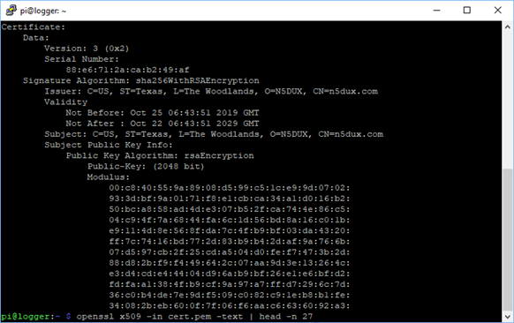
Remote access
SSH (Secure Shell)
Encrypted terminal communication
Replaces Telnet

Slide 11
Domain name resolution
DNS had no security in the original design
Relatively easy to point a DNS
DNSSEC
Domain Name System Security Extensions
Validate DNS responses
Origin authentication
Data integrity
Public key cryptography
DNS records are signed with a trusted third party
Signed DNS records are published in DNS
DNS over TLS
DNS over HTTPS

Slide 12
Routing and switching
SSH – Secure Shell
Encrypted terminal communication
SNMPv3 – Simple Network Management Protocol version 3
Confidentiality – Encrypted Data
Integrity – No tampering of data
Authentication – Verifies the source
HTTPS
Browser-based management
Encrypted communication

Slide 13
Network address allocation
Securing DHCP
DHCP does not include any built-in security
There is no “secure” version of DHCP
Rogue DHCP servers
In Active Directory, DHCP servers must be authorized
Some switches can be configured with “trusted” interfaces
DHCP distribution is only allowed from trusted interfaces
Known as DHCP Snooping

Slide 14
Network address allocation
DHCP client DoS – Starvation attack
Use spoofed MAC addresses to exhaust the DHCP pool
Switches can be configured to limit number of MAC address per interface
Disable an interface when multiple MAC addresses are seen

Slide 15
Subscription services
Automated subscriptions
Anti-virus / Anti-malware signature updates
IPS updates
Malicious IP Address databases / Firewall updates
Constant updates
Each subscription uses a different update method
Check for encryption and integrity checks
May require an additional public key configuration
Setup a trust relationship
Certificates, IP addresses

